Slide 1

FINAL PRESENTATION
Conway’s game of life
By Yongjin Yang & Luxin Wang

Slide 2
Basic functions
Size: 100*100; speed: 100ms/round (supported size: 400*400)
Play/Pause (automatically run)
Restart
Round counter (timing)
Initial pattern

Slide 3
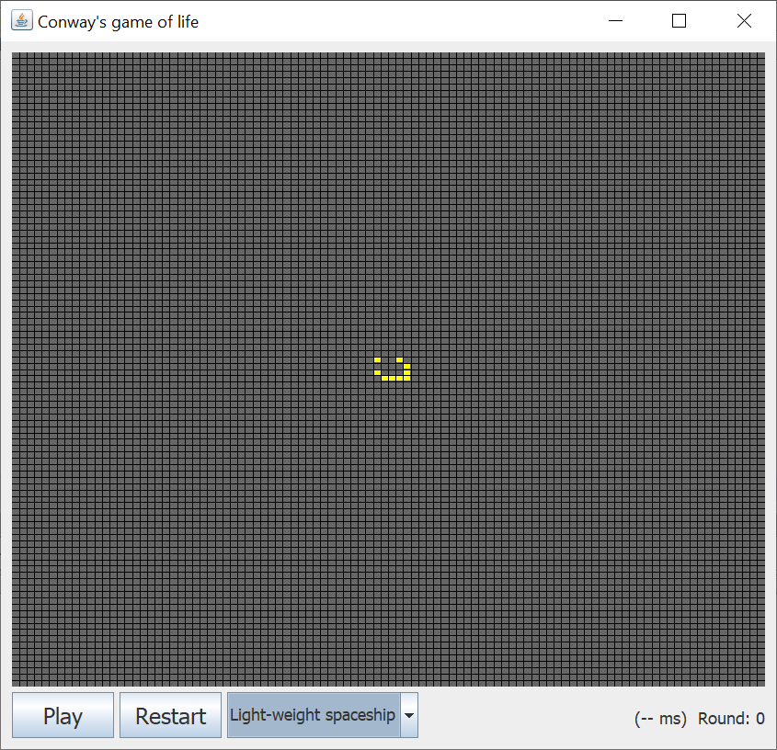

Slide 4
How we meet the requirements
GUI - java.awt.*/javax.swing.*
Game Rule – 2-dimensional Array
Parallel - Thread

Slide 5
OUR GOALS
Test Time (Such as time required to run 1000 times)
Improve the speed (using parallel computing)
Can handle the large map

Slide 6
Final Presentation
About Thread
Add thread through implements runnable method. We try to separate the map into 4 parts as 4 threads to improve the speed. However, we find that the threads actually didn’t make the code faster and even a little slower.
too many threads?
map is too small?
Notes:
Maybe we add too many threads, or maybe our map is too small to take the advantage of threads.

Slide 7
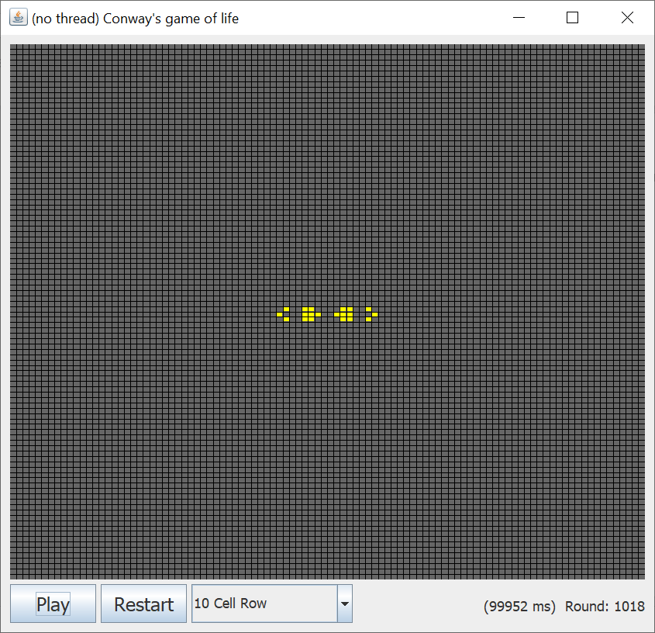
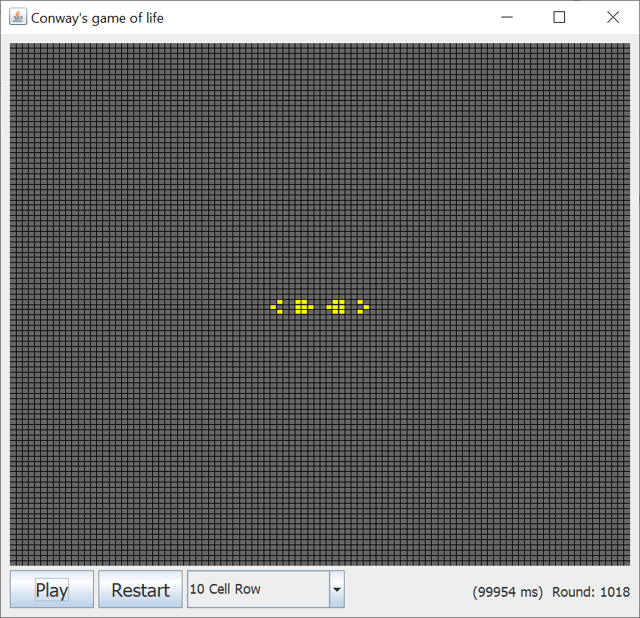
Final Presentation

Slide 8
About Large Map
We use the method Graph.setLine() to grid the map, since the window has size limit, if we set the size larger than 400, we cannot draw on the map any more.

Slide 9
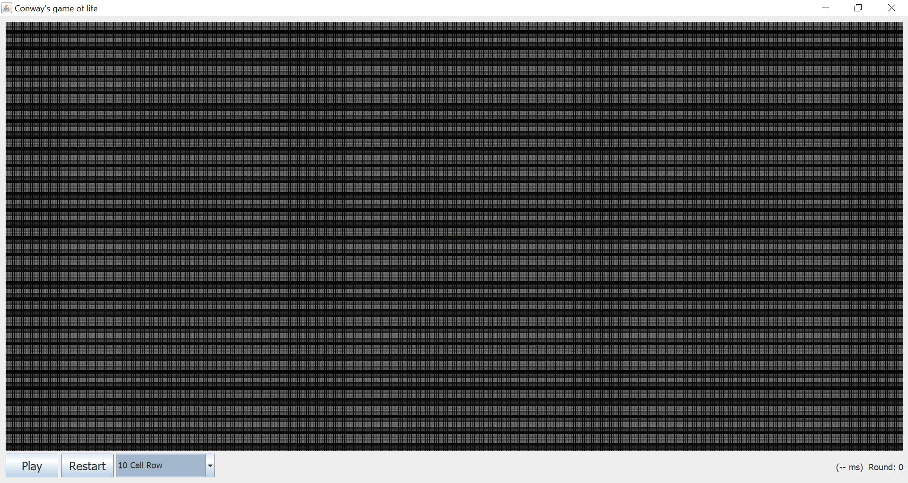

Slide 10
Thank You

